Slide 1




Creative
Strategy
Presented By :
Creative Strategy for Pinnacle 2025
Media Unit
Pinnacle 2025
1

Slide 2


MEDIA UNIT
Visual
Identity
*theme
01
Logo
02
Color Palette
03
Fonts &
Typography
2

Slide 3





MEDIA UNIT
Logo
01
Slogan
03
Brand Mark
E.g. Just do it.
*simplify
02
Word Mark
04
Combination Mark
*perfect
3

Slide 4
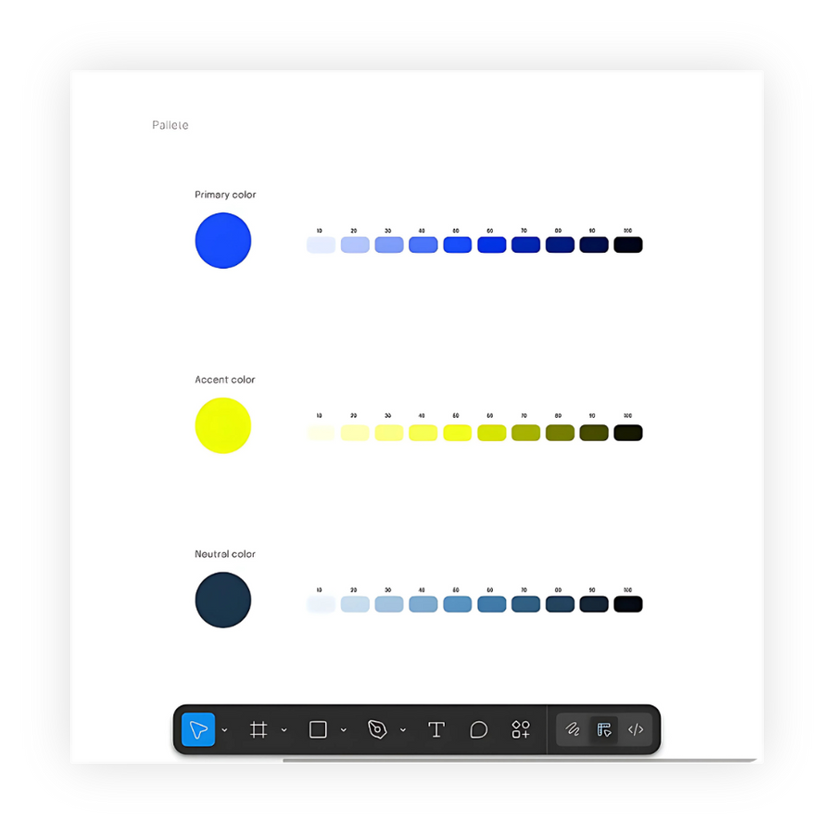




MEDIA UNIT
Color Palette
Primary Color
*perfect
Accent Color
Neutral Color
4

Slide 5




MEDIA UNIT
Fonts
&
Typography
Font
Pairings
heading
subheading
body
Font sizes
Spacings
5

Slide 6
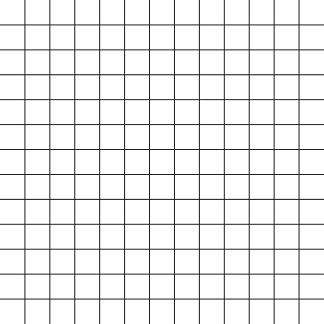

MEDIA UNIT
Key
Contents
Graphics
Videos
6

Slide 7
MEDIA UNIT
01
Logo Pack
E.g. Black/White/Color versions
02
Custom icons for each category
Graphics
03
Countdown Visuals
Templates
&
04
Judges/special guests reveal
05
Announcements
E.g. Category intros/Rules/Winners
7

Slide 8
MEDIA UNIT
Videos
Templates
&
01
Animated Teaser
04
Judges/special guests reveal
logo reveal + theme music
02
05
Behind
the Scenes (Optional)
Intro/Outro
03
Countdown Visuals
8

Slide 9




MEDIA UNIT
*have you tried?
01
Photoshop
Collaboration
02
Canva
Internal Flow🤝
03
&
Premiere Pro
04
Capcut
05
Figma
Tools
9

Slide 10
MEDIA UNIT
Thoughts?
10

